Slide 1

BLUE MANGOES
Piyush Khemka, Prachi Poddar, Snigdha Kamal, Sharang Bhat

Slide 2
MUSIC RECOMMENDATION
SYSTEM
Based on Million Song Dataset*
*labrosa.ee.columbia.edu/millionsong/

Slide 3
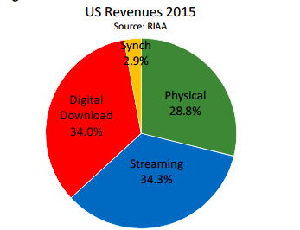
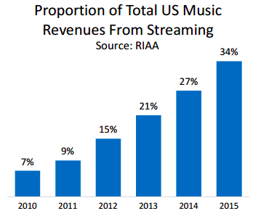








Background and Motivation
Growth in Music streaming consumption among consumers
Plethora of options available - Spotify, Pandora, 8tracks
*http://www.riaa.com/reports/riaa-2015-year-end-sales-shipments-data-report-riaa/
RIAA - Recording Industry Association of America

Slide 4
Background and Motivation
Music Recommendations - excellent feature for any music application.
Better Recommendations - Better Conversions, More engagement
Develop a music recommendation system based on the Million Song Dataset using various recommendation methodologies and draw a comparative analysis between them

Slide 5
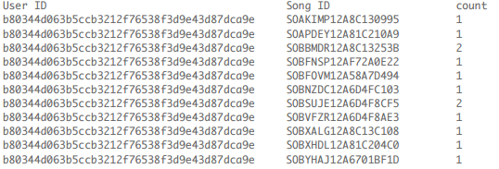
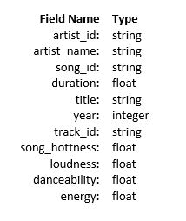
Dataset Description
The Million Song Dataset User Taste Profile Dataset
Freely available collection of audio features and metadata 48 million triplets(User Id, Song ID, count)
for a million contemporary popular music tracks ( 280 GB) Gathered from 1 million users
1 M songs.
Subset: 2.8 GB (compressed) -> 10 GB (CSV) Size: 500 MB (compressed) -> 3 GB (.txt file)

Slide 6
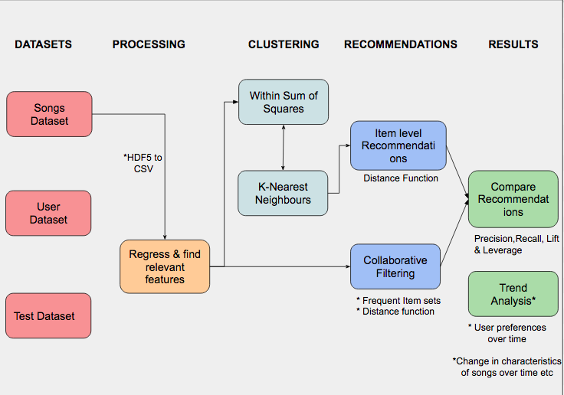
Project Pipeline

Slide 7
Collaborative Filtering
The Collaborative Filtering method uses previous user choices, and choices of similar users to predict the possible future song selections
Data was first fed through a data cleaning module, which removed erroneous entries, such as missing values for both Song and User ID’s.
ID’s were then mapped to a unique integer via a dictionary as Spark functions require numeric values
A reverse lookup RDD was created to map songs back to their original ID’s

Slide 8
Collaborative Filtering
Used Matrix Factorization instead of the conventional distance function
Latent factor methods were used to train on some known data
K User Features (latent) were extracted , which in this case was the song count
Assumption-Song Count represents all the factors that could have contributed to a user choosing to listen to a song
Trained over different values of K (ranks) and selected best rank to use for testing
Testing Method 1- Cross validation
Testing Method 2-Trained over entire set of 48 Million Users, and tested on 4 testing datasets provided

Slide 9
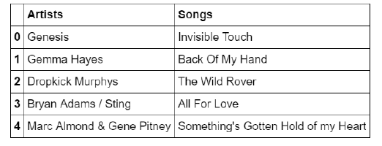
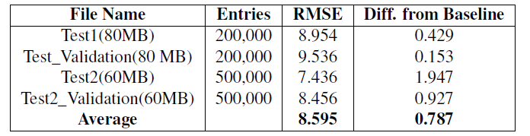
Results - Collaborative Filtering

Slide 10
Content Based Recommendation
We extracted certain features from the dataset, which describes features of a song
Normalized those features by taking its product with its confidence to get a final value, such as mode and mode confidence to get a final mode estimate
Removed features not related to audio features
Clustered songs in a higher dimensional space, and found similar songs within each cluster

Slide 11
Content Based Recommendation
Training Method- Cross Validation
User-triples dataset was split in a ratio of 80:20.
80% of the dataset was used to train a clustering model
Created a profile for each user by merging the user-song dataset
Each user profile consisted of a “mean” of all songs heard by a user in his lifetime (as per the dataset)
Clustered using K-means

Slide 12
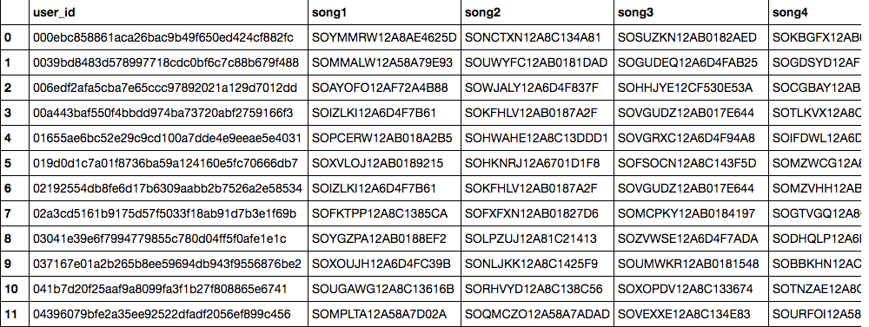
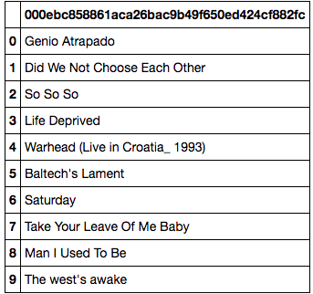
Content Based Recommendation
Testing
Generated 10 nearest neighbours for each user
Evaluated by comparing recommendations to actual values present in the dataset

Slide 13
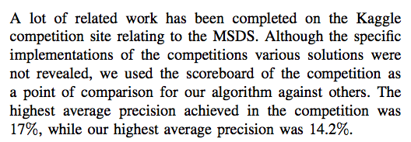
Results - Content Based Filtering
Precision = True Positives / (True Positive + False Positive)
Final Precision- 6.1% on entire MSD subset
Performance for Content Based decreases with increase in size of data
*
* http://www-personal.umich.edu/~yjli/content/projectreport.pdf

Slide 14
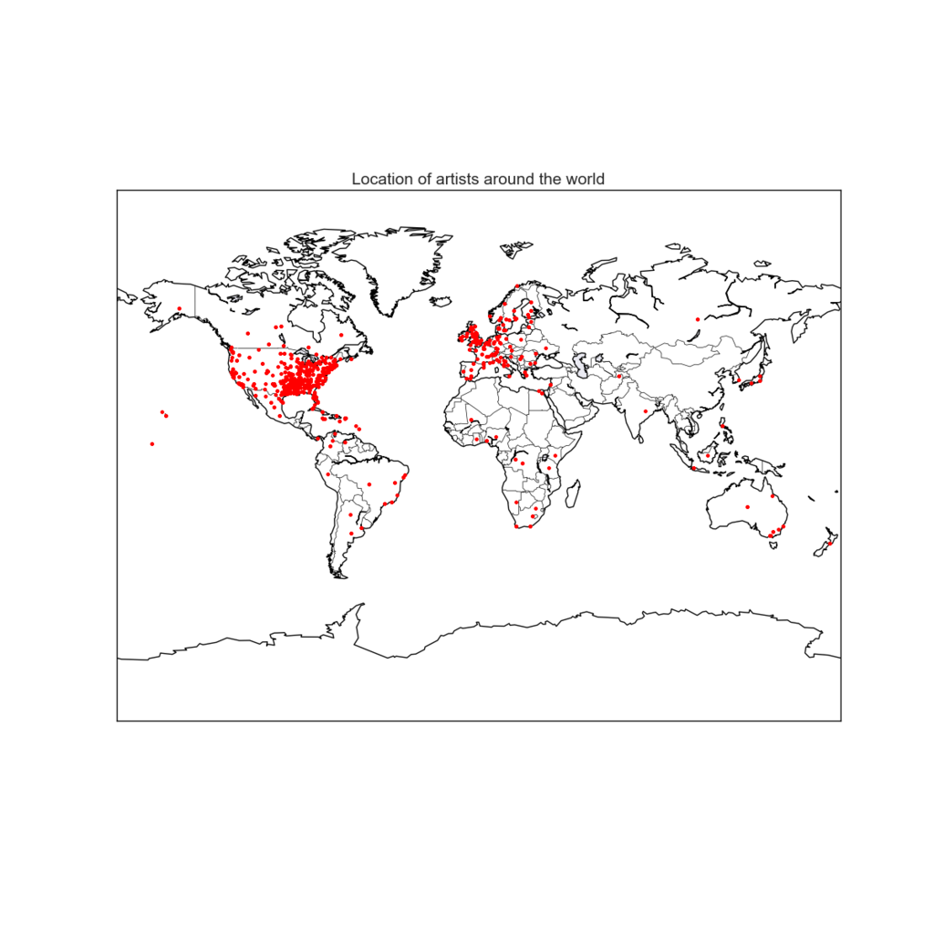
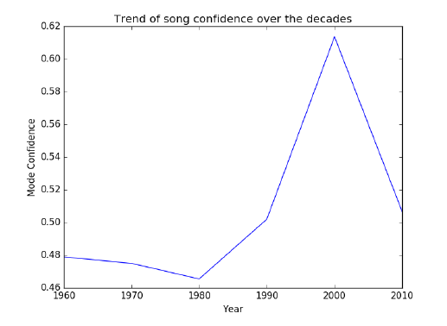
Visualizations and Trend Analysis

Slide 15
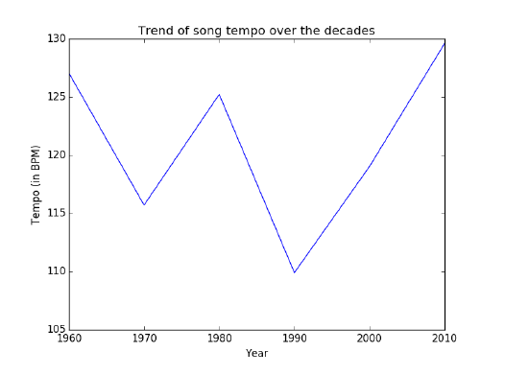
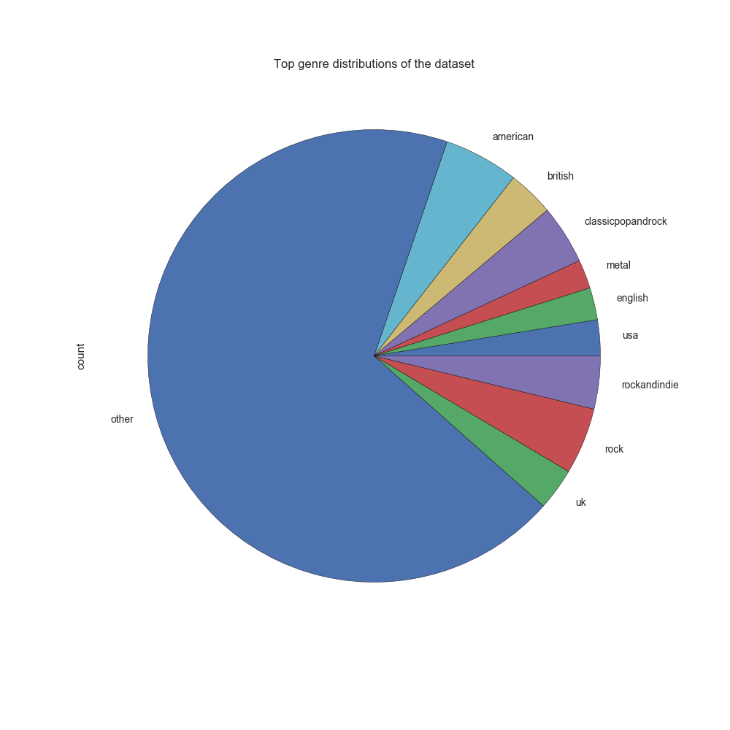
Visualizations and Trend Analysis

Slide 16
Team Work
Scoping the project, data extraction, data cleaning - All
Collaborative Filtering - Sharang
Content Based Filtering - Piyush
Trend Analysis & Visualizations - Prachi, Snigdha
Conclusion, Report, Presentation - All
Asking questions on Piazza - Anonymous

Slide 17
Conclusion
Eye opener on big data and its difficulties
We were fairly satisfied with our results, we managed to reduce the RMSE by almost 1, and virtually predicted how many times a user will play a song
We fairly satisfied with a precision of 6.1 % considering we tried a new recommendation methodology
Collaborative Filtering was easier to implement and evaluate
Unearthed some interesting music trends from across the years

Slide 18
THANK YOU

Slide 19
Audio Source Separation Using Neural Networks
Austin Borger, Anjaly Mehla, Sourav Mishra, Rakshit Gautam, Yingru Liu

Slide 20
Overview
Mixtures of signals are created using superposition (addition)
Once two signals are added together, it is hard to get them back
Humans / animals can focus on different signals in the mixture easily, but machines have a hard time
A machine learning approach is necessary to retrieve the original signals

Slide 21
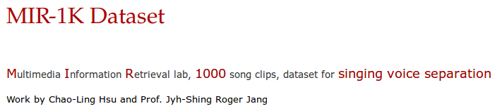
The MIR-1K Dataset contains singing voice and background music examples for training a machine learning algorithm to separate audio sources
Several different voices & background instruments
https://sites.google.com/site/unvoicedsoundseparation/mir-1k

Slide 22
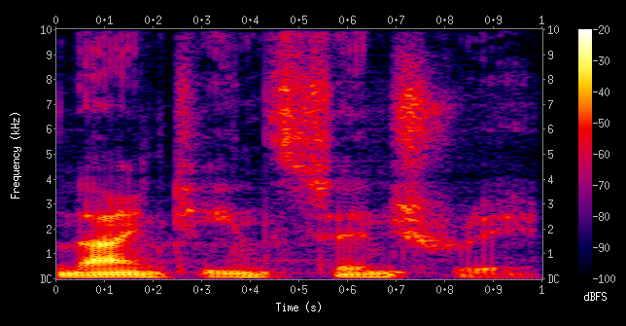
Feature Vector
Spectrogram with N frequency bins (features), M time samples (observations)
Data in float32 or float64 between 0.0 and 1.0, serves as input into the neural network

Slide 23
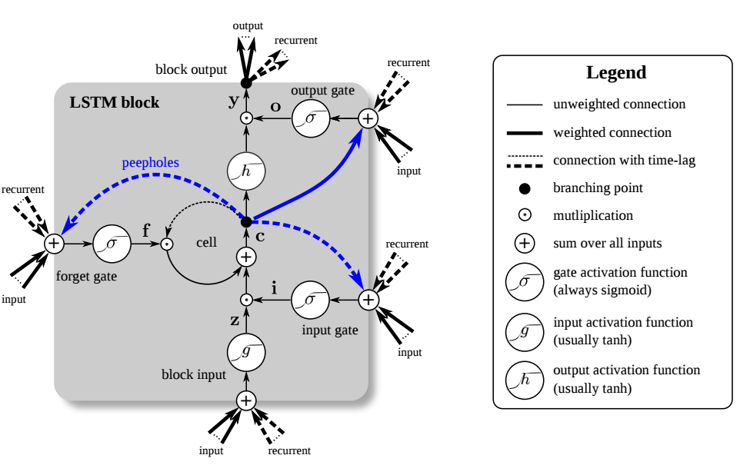
Method: LSTM Network
A special kind of recurrent neural network designed for long term memory
Perfect for sequences where past events influence understanding of future events

Slide 24
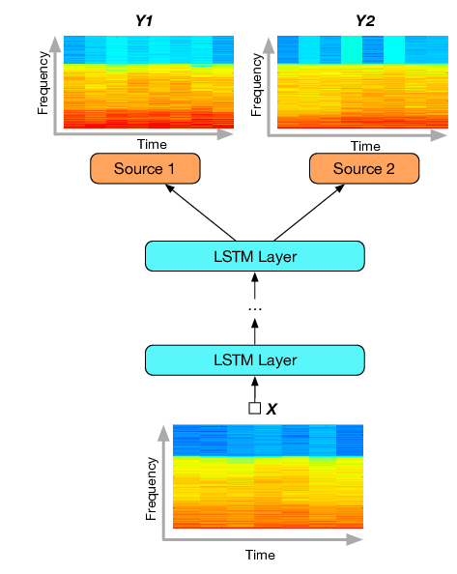
Normalized power spectrum of audio mix enters the network
Two sources, Y1 and Y2 exit the network in a similar form
Use of multiple LSTM layers increases contextual computation
Network is trained over many epochs to reduce the cost (error) as much as possible

Slide 25
Results
Training took four hours for 256 frequency bins on four different one-second inputs at a 16000 Hz sampling rate
Root-mean-squared error fell exponentially per epoch, settling at ~1.0

Slide 26
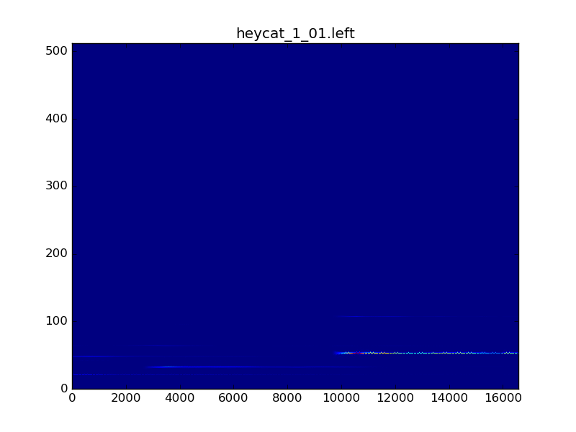
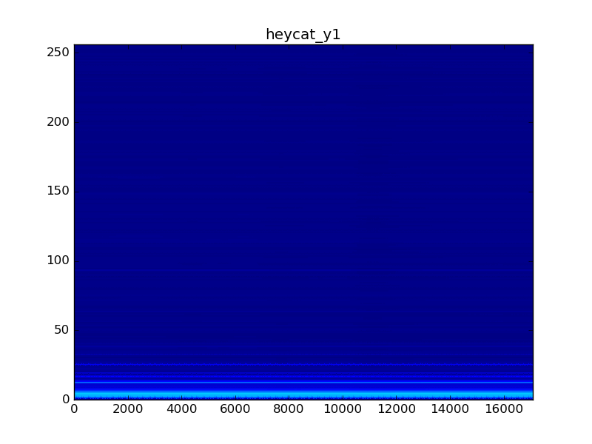
Unfortunately...

Slide 27
Discussion
Deciding on a neural network shape is difficult
Success requires a lot of trial and error testing on many different inputs (requires more time)
A future successful approach would model past papers, and then make adjustments to increase accuracy or computational efficiency
Looking to a paper by Paris Smaragdis as University of Illinois, which uses the time series directly and achieved success

Slide 28
Conclusion
We are looking forward to continuing this project outside of class
An accurate audio source separator is a big necessity in machine listening and for advances in signal processing
Could help in many different areas besides audio, including medical imaging and analysis of brain activity

Slide 29
D-Company
Aravind Warrier
Arun Babu
Aviral Nigam
Syamsankar K S

Slide 30
Authorship Attribution: Comparison between Spark and Hadoop Map Reduce
Aravind Warrier
Arun Babu
Aviral Nigam
Syamsankar K S

Slide 31
Big Picture Scope
What is Authorship Attribution problem?
A person’s writing style is an example of a behavioral biometric.
The words people use and the way they structure their sentences is distinctive, and can often be used to identify the author of a particular work.
Problem is defined as predicting the author of a text from a list of possible candidates by looking at textual features.

Slide 32
Big Picture Scope Cont’d.
Why is it important?
For historic texts, authorship attribution helps in identifying the documents written anonymously or under pseudonym.
In literary research, authorship attribution helps to resolve disputed authorship for unknown documents.
In academic research domain, authorship attribution helps to unveil plagiarism, anonymous authors etc.

Slide 33
Motivation
Tackle the interesting problem of Authorship Attribution.
How to choose between Hadoop MapReduce and Spark? Better understanding of major architectural components : shuffle, execution model, and caching
Performance vary greatly depending on the use case under consideration and specific algorithms being used.
Not many comparison studies has been done on Authorship Attribution problem.
Notes:
Aravind
There are so many techs available
Hadoop and map reduce are two common technologies
Our project aims in better understanding the major archichtecurtal components
Also how the data passing affects the entire run time
Performance varies

Slide 34
Data Description
Source
Academic Papers (Researches on Big Scholarly Dataset)
provided by CiteSeerX contains 2,118,122 dissectible academic research papers
Data
Data consists of two parts : TXT files and XML files
TXT files contains every sections of the paper like title, authors, abstract, full paper text, references.
XML part contains metadata about the paper which includes author names, affiliations etc.
Volume used for experiment.
We conducted experiments with a small portion of the total available dataset. Training was done with different sizes for analysis.
Notes:
Aviral

Slide 35
Methods Used
Tokenizer
(mapper only job)
IDF Counter
(mapper - partial counts
reducer - no of docs with token)
Filter
(Remove infrequent words and give ids)
Output : Set of words with unique ids
Naive Bayes for final model
TF IDF Vectorizer
(mapper - calculate tfidf )
Notes:
Arun
map only process and not having a reducer eliminates shuffle and sort that could have hindered the speed
Tokenizer produce n grams => we plan to test for multiple ns
IDF counter => we need to find the occurrence of a word in different documents hence for each doc emit (word, 1)
In the filter remove words which dont satisfy a limit
If we reduce the threshold value we will have more feature
Calculate tf-idf
Use tf-idf values instead of counts for probablity calculation in naive bayes

Slide 36


Preprcessing and Splitting
clean.py
splitter.py
Map Reduce
Spark
Eclipse Project : FinalBigDataProject
Commandline parameters are as below
MainClass : NaiveBayesMapReduce
Input folder
Output folder
Ngam Size
Number of documents
Idf threshold
Spark Script spark-script.py
Command line parameters are as below
Input File
Output file
Ngram size
Number of documents
Idf Threshold
Final Testng
testing.py

Slide 37
Different challenges in implementations
Map Reduce
Different input formats needs to handed with custom classes.
Need to take care of data being transferred from different map-reduce stages
Distributed cache has to be used to transfer data between different stages.
Many nitty gritty details to be dealt with during implementation
Spark
Hard to implement logic which doesn’t suit the map/reduce style
Sharing the data between different RDDs is not easy

Slide 38
Specific Experiments / Analyses Conducted
Changing the size of data set
300MB and 750MB
Changing the Idf threshold value
80 and 30
Changing the number of features
Note: Cluster Config: 1 Master, 2 Slaves, RAM: 8G

Slide 39
Results - Performance
N gram size | IDF Threshold | Number of features (word count) | MR Execution time(s) | Spark Execution time(s)
Unigram | 80 | 2091 | 576 | 72
Unigram | 30 | 10994 | 597 | 74
Bigram | 80 | 394 | 835 | 96
Bigram | 30 | 2030 | 930 | 107
Trigram | 80 | 211 | 1012 | 110
Trigram | 30 | 915 | 1016 | 107
Table 1: Analysis on 300 MB
Notes:
Patterns are
Spark better than mr
Difference in uni,bi and tri is not very significant. It may be due to the tokenization logic
Explain why we are tuning idf threshold => affects no of features
Idf threshod is tunable.

Slide 40
Results - Performance
N gram size | IDF Threshold | Number of features (word count) | MR Execution time(s) | Spark Execution time(s)
Unigram | 80 | 6572 | 1203 | 145
Unigram | 30 | 34053 | 1285 | 153
Bigram | 80 | 816 | 4505 | 530
Bigram | 30 | 4860 | 4611 | 510
Trigram | 80 | 338 | 5314 | 584
Trigram | 30 | 1840 | 5376 | 572
Table 2: Analysis on 750 MB
Notes:
Shyam

Slide 41
Discussion
New ideas like in-memory computation gives spark and advantage over Map Reduce which has to persist files to disk after each stage of computation.
Spark out performs Map Reduce in all the scenarios we tried.
In an algorithm like Naive Bayes which essentially involves many variations of Word Count problem, Spark with its more efficient hash based combiner works better than map reduce.

Slide 42
Conclusion
Successfully implemented Naive Bayes in both Spark and Map Reduce and compared its performance
Found the performance of Spark to be better in all cases
As future work, using these implementations analysis can be done on different workloads, different cpu configurations etc.
Notes:
Since we have the implementation this can be used to anayse various aspects like perfromance under different workloads, analysis with different machine configurations, stagewise analysis.

Slide 43
References
A Straightforward Author Profiling Approach in MapReduce link
Overview of the Author Profiling Task at PAN 2013 link
Overview of the Author Identification Task at PAN 2015 link
Clash of the Titans: MapReduce vs. Spark for Large Scale Data Analytics link
Academic Papers (Researches on Big Scholarly Dataset) link

Slide 44
Thank you !!!

Slide 45
Analysing Yelp Data Using Spark
Data Crunchers
Aditi Singh, Deepak Goyal , Daniel Myrick

Slide 46
Big Picture Scope
Yelp, is a crowd-sourced local business review and social networking site. A few interesting facts about Yelp.com:
Business owners can setup a free account to post photos and messages their customer.
168 million unique visitors per month in Q2 2016
108 million reviews by the end of Q2 2016
As Yelp has millions of visitors per quarters, there are a lot of interesting patterns and trends hidden in the Yelp datasets that we will try to uncover in this project.

Slide 47
Motivation
Business Popularity :
The businesses, based on these insights, can understand their strengths and weaknesses
Businesses would have outlets in different locations, determine the geographical preferences of the people in general
User Benefits : a. Using new insights and trends, users can make better decisions
c. Follow trendsetters and influencers in the community
d. Explore top businesses in the vicinity

Slide 48
Yelp DataSet Description
2.7M reviews and 649K tips by 687K users for 86K businesses
566K business attributes e.g hours, parking availability, ambience
Social network of 687K users for a total of 4.2M social edges
Aggregated check-ins over time for each of the 86K businesses
Using 3 data sets from the previous challenges (total size > 5GB) to get the analysis

Slide 49
Methods
Data Pipeline : Spark
Analytics :
Mining Social Network Graphs
Using user and friends graphs to find communities - label propagation + degree count
Further analysis on the graph to get PageRank to show importance of users.
Social Media Text Analysis
Predicting business ratings based on users’ review’s text using sentiment analysis
Clustering
Geospatial clustering of the business and finding the peak times with check-in information

Slide 50
Specific Experiments / Methods:
Predicting Rating using Sentiment Analysis on user reviews
Data Preprocessing
Tokenize reviews
Convert words to lowercase
Feature Extraction
Remove stop words - to get only important words
Perform Porter Stemming - to reduce redundancy
Compute Hashed TF for reviews to get feature set
Classification
Convert each review into a LabeledPoint dataset
Train Naive Bayes Classifier and predict ratings
Compute Precision and Recall from predicted ratings

Slide 51
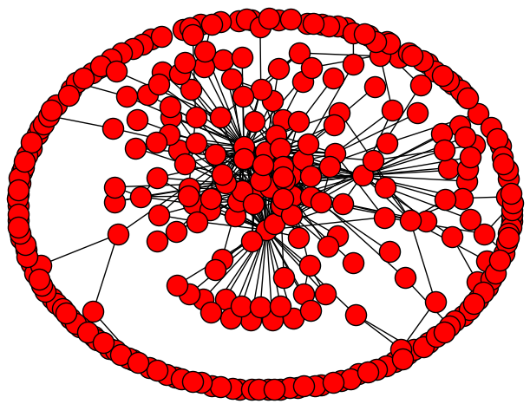
Specific Experiments / Methods:
Mining Social Network Graphs
- Used these two packages:
- Com.databricks:spark-csv_2.10:1.2.0
- Graphframes:graphframes:0.1.0-spark1.6
- Filtering: User_id , Friends , review_count , number of fans.
- Graph Construction:
- Edge links between a user and each of it’s friend.
- Undirect it - ad reverse link and union
- GraphFrames’ API to create graph - hash user-ids
- Algorithm:
-set maxIterations as 20 and run Label Propagation - get final labels .
- unique labels= # communities
- run PageRank - labels against ids = importance value
- Verification step
- serial vs parallel.

Slide 52
Specific Experiments / Methods:
Clustering
Filtered set to be resturants with checkins
DBSCAN algorithm is used for clustering
Clustering based on latitude and longitude euclidean distance
Create check-in data for each cluster
Add check-ins from each location
Divide by the total check-ins for each day
Graphing the output data will give percentage of daily use for a day for each region
Similarity Calculations
Made each region into a single week array
Found cosine similarity matrix for the entire set
Using the matrix regional similarity and difference can be analyzed

Slide 53
Results & Discussion

Slide 54
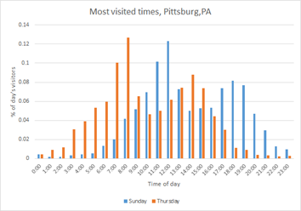
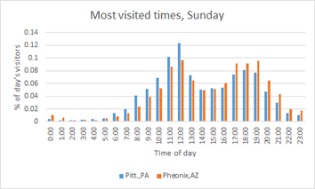
Clustering
Most Similar: (Pittsburgh, PA) (Las Vegas, NV), 0.996923271786
Least Similar: (Laval, QC) (Edinburgh, EDH), 0.0
Sunday(Blue) vs Thursday(Red) percentage of daily visitors based on time
Pitt., PA (Blue) vs Pheonix, AZ (Red) percentage of daily visitors based on time

Slide 55
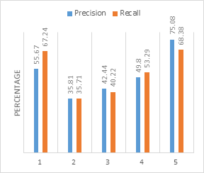
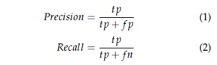
Predicting Ratings from review text
Rating | 1 | 2 | 3 | 4 | 5
1 | 70059 | 23182 | 5191 | 2270 | 3483
2 | 18205 | 27078 | 21367 | 6106 | 3082
3 | 9918 | 15181 | 45314 | 33485 | 8758
4 | 9116 | 6990 | 28065 | 126291 | 66514
5 | 18543 | 3188 | 6834 | 85461 | 246599
Table 1: Actual(row) vs predicted(col) ratings
Notes:
Mention the behavior observed here for rating 1 and 5
We can observe that precision and recall are significantly better for rating 1 and 5. Since we train the features based on only positive and negative sentiments, it is difficult to predict how positive or negative the sentiment is.

Slide 56
Graph Analytics
TABLE 1 . Label Propagation Results
# Nodes: | 1068280
# Edges: | 1756400
Average in degree: | 0.09938967
Average out degree | 0.09938967
# Communities after convergence | 59
Vertex_id after Hashing | PageRank Score
-273274164333269232 | 0.01282966757255631
6599773768587771628 | 0.01008873149553113
3808083818772441758 | 0.01359863467901169
-4922270516981188691 | 0.01285090841353462
-6998050434137289598 | 0.014564282704022644
-2498744243720800495 | 0.01164259093714315
-88644814267475477 | 0.016874275630388357
3063986351582762325 | 0.014558632313540768
6318785792058904764 | 0.04420961554376199
Vertex_id after Hashing | PageRank Score
2235434161641890545 | 0.271184085305455
-6149661098834536439 | 0.36729737086511
2880520158677959518 | 0.25081399427392
-1898622742239194767 | 0.19500503875896
9087661216231607023 | 0.23267559419677
6077097343232981159 | 0.18962021138116
-7033461524680163606 | 0.170840729124987
6126934598131109890 | 0.173335523114575
TABLE 2. Label Propagation Results
# Nodes: | 4592
# Edges: | 1122471
Average in degree: | 23.0958188
Average out degree | 23.0958188
# Communities after convergence | 31
TABLE 4
PageRank based on threshold
TABLE 3
PageRank Based on MaxIterations

Slide 57
Conclusion
Through this project we learnt:
How to handle large data and parallelize the process - spark
Find the user communities, user who are influencers - graph
How well we can predict business ratings from review’s text.
What are the max peak hours of people geographically - geo information

Slide 58
References
[1] Yun Xu, Xinhui Wu, Qinxia Wang. “Sentiment Analysis of Yelp’s Ratings Based on Text Reviews”, 2014
[2] https://en.wikipedia.org/wiki/Label_Propagation_Algorithm
[3] http://graphframes.github.io/user-guide.html#motif-finding
[4] http://spark.apache.org/docs/latest/graphx-programming-guide.html
[5]https://www.oreilly.com/ideas/clustering-geolocated-data-using-spark-and-dbscan

Slide 59
Thank You

Slide 60
Deep Divers
Pooja Sonawane, Nikhil Junneti, Umesh Jain, Sandeep Sunia

Slide 61



Airline Delay Prediction
Nikhil Junneti
Pooja Sonawane
Sandeep Sunia
Umesh Jain

Slide 62
Big Picture Scope
Each year, US has around 9 million commercial flights of which, approximately 25% are delayed. ^{[1]}
These services are used by approx. 0.8 billion passengers.
Delay causes huge losses to airlines and passengers.
If passengers have information about approximate delay, then they can book flights and plan accordingly to avoid losses.
Airlines can also understand the factors affecting delays and improve operations.
[1] http://www.rita.dot.gov/bts/press_releases/bts018_16

Slide 63
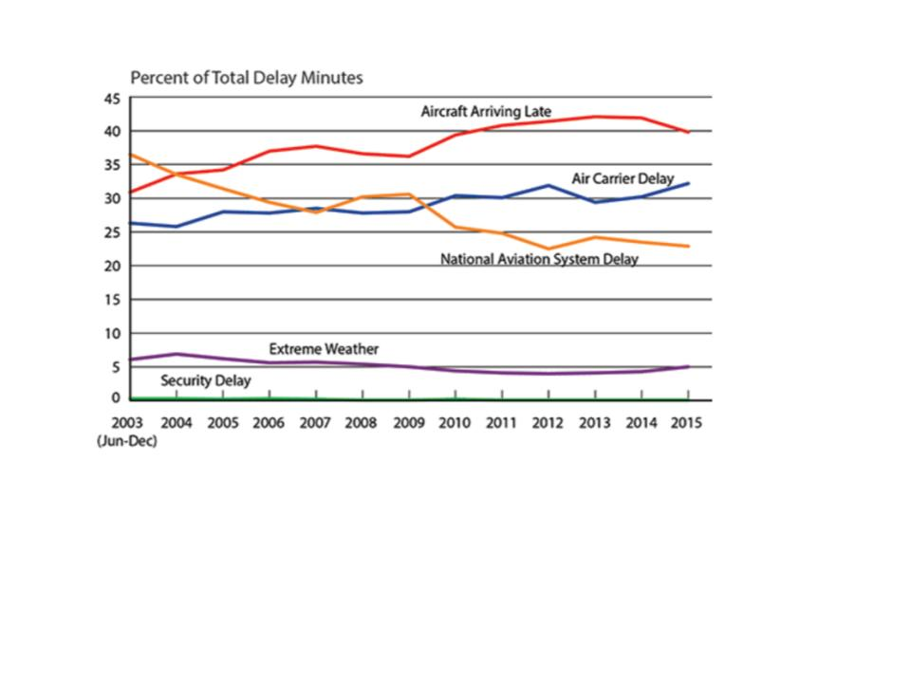
Why should we care?
Cost Component | Cost ($ billions)
Cost to Airlines Cost to Passengers Cost from Lost Demand | 8.3 16.7 3.9
Total Direct Cost | 28.9
Impact on GDP | 4.0
Total Cost | 32.9
http://news.berkeley.edu/2010/10/18/flight_delays/

Slide 64
Data
We had on-time performance data of 29 domestic airlines, 305 airports in the US with 30 features taken from http://www.transtats.bts.gov.
We collected data from 2006 to 2016, which contributed to a total of 6GB, for first part.
Features: date, day of week, carrier code, origin, destination, delay time, cause of delay, TaxiIn, TaxiOut times,
For second part, we had 678 features which contributed to a data size of approximately 1.2 GB for the month of September 2016

Slide 65
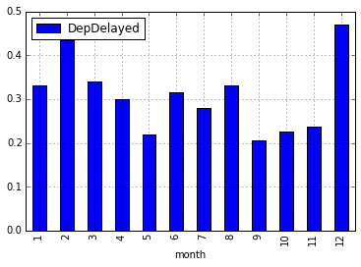
Analysis: Effect of month of the year
Average delay times across all airports are different in different months
Peaks in February and December - can be expected because of long holidays

Slide 66
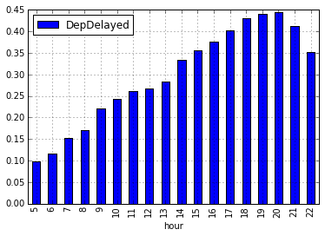
Analysis: Effect of Hour of the day
Delay times change with hour of the day.
Flights towards the end of the day experience more delays than in the early part of the day with peak at 8PM

Slide 67
Methods- Part 1- Preprocessing
Classification Problem
Predict Delay(time>15min)/No Delay(time<15min)
Feature Selection:
Year
Month
Day of Month
Day of week
Hour of the day: 0-23
Distance between Origin and Destination
Days from nearest federal holiday

Slide 68
Methods-Part1 : Models
Baseline Model
Zero Rule algorithm: Predicts no delay for all flights
Approximately 5/6th of the flights are on time.
Advanced Models
Logistic Regression Classifier with SGD
Decision Tree Classifier
Random Forest Model
Multi class decision tree classifier
Overall accuracy 54%
time<=0
0<=time<10
10<=time<20
20<=time<30
time>30

Slide 69
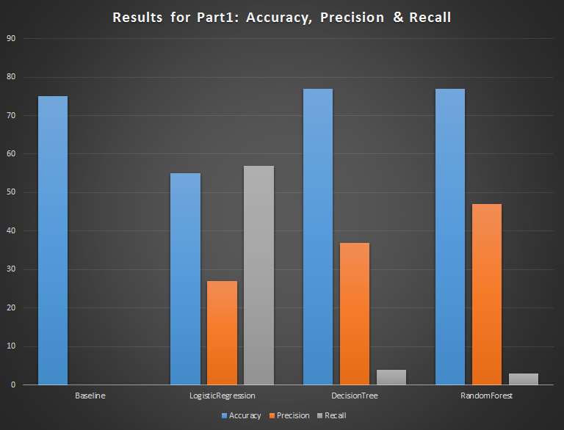

Slide 70
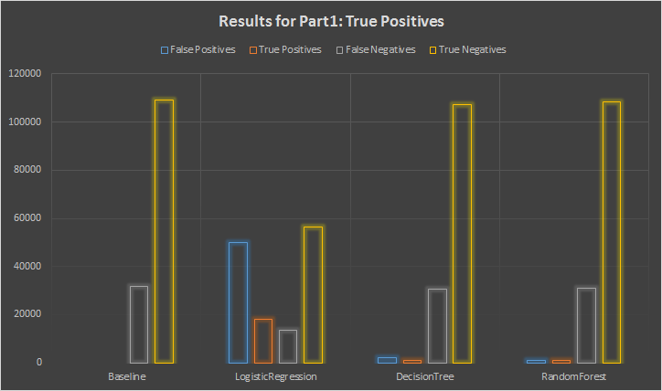
Results and Discussion

Slide 71
Methods-Part2 : Preprocessing & Models
Categorical Features:
Day of the week
Origination
Destination
Unique Carrier Identification Code
Numerical Features:
Distance between Origin and Destination
Hour of the Day
Models Tested:
Logistic Regression Classifier with SGD
Decision Tree Classifier

Slide 72
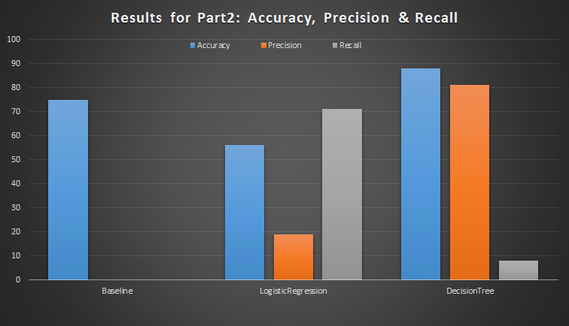

Slide 73
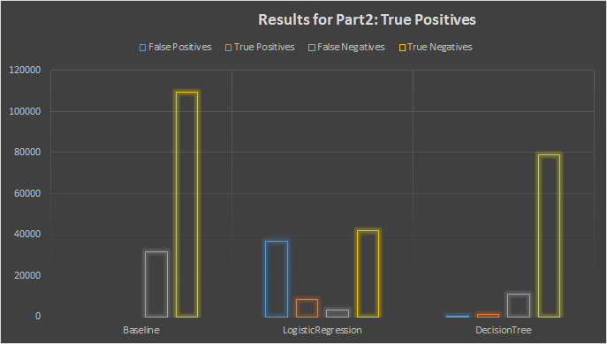
Results and Discussion

Slide 74
Streaming Data
We have implemented streaming on incoming data from a DStream .
We load the pre-trained Decision-Tree model and pass the DStream through it for prediction.
We have used “textFileStream” which only picks up the data from new files. It only ingests data newly placed in the source directory once the streaming is up.
So, when a new file with flight records is added to the source directory it picks up the file for streaming passing it to the model for prediction .

Slide 75
Streaming Flow
Input Stream Process & predict
Data
R6, R5, R4, R3
D4,D3,D2,D1,......
Input DStream
Flight records.
Pre-trained Decision Tree Model
Output Stream predicting delays.

Slide 76
Conclusion
Decision Tree is better overall.
Federal Holidays had little impact on predicting flight delays.
Delays are more dependent upon airport and airline.
Encoding categorical variable to numerical gave very good results indicating predicting power of those variables.
Could be enriched with weather data but requires more space and computation power.

Slide 77
References
http://www.rita.dot.gov/bts/press_releases/bts018_16
http://news.berkeley.edu/2010/10/18/flight_delays/
https://spark.apache.org/docs/1.2.0/mllib-guide.html

Slide 78

Thank You!

Slide 79
BREAK

Slide 80
Long Tail Recommendations using Amazon Product Dataset
Team Pandas
Anvika , Nipun Bayas, Rakesh Agarwal, Sudeshna Pal

Slide 81

Table of Contents
Big Picture Scope
Motivation
Data Description
Methods
Results/Evaluation
Discussion
Conclusion
https://reviewediting.files.wordpress.com/2012/07/contents.jpg

Slide 82
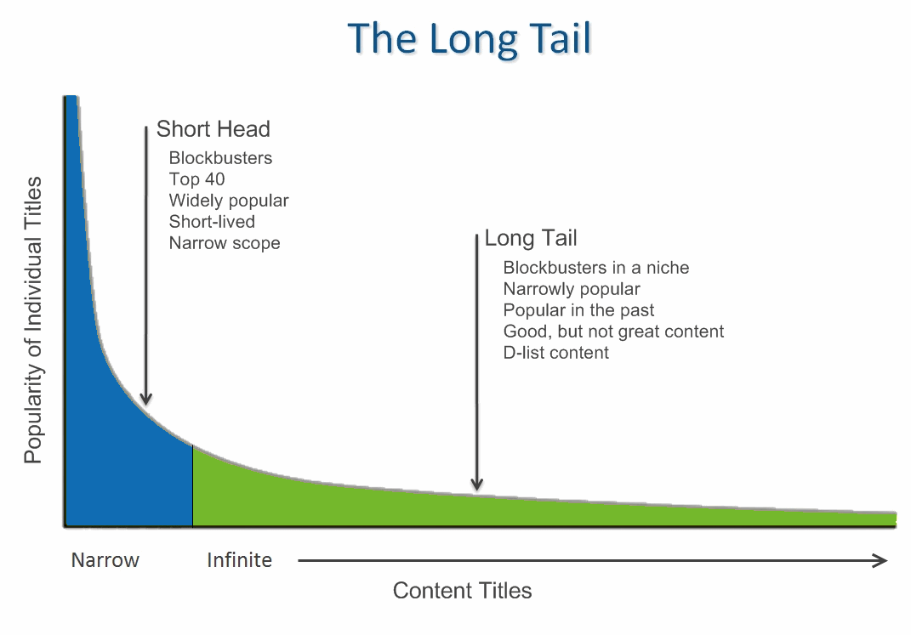
Big Picture Scope
Boosting recommendations from the long tail of the Amazon product dataset

Slide 83
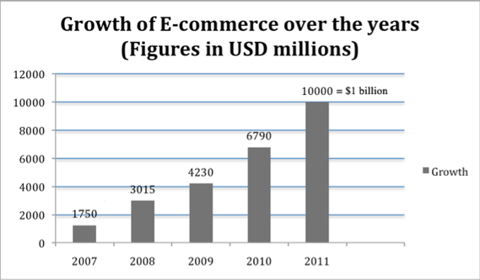
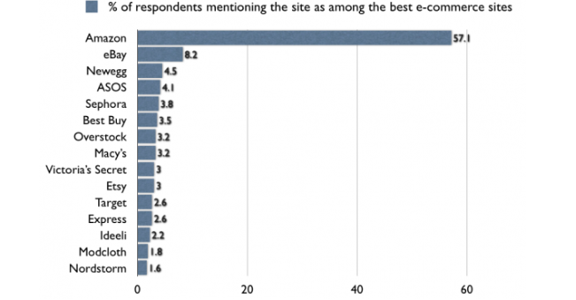
Motivation
Online shopping has been a growing trend for over the past decade

Slide 84
Motivation cont’d
Rich get richer concept, popular products get recommended more, while some products get lost in the Long Tail
Helps some of the amazing, yet not so popular products to reach the head
Different products and diverse options for users to choose from

Slide 85

Data Description
Data Source:
Amazon product reviews: 1996 to 2014
Volume:
Metadata: 3.1GB
Several categories combined: 12GB containing 140 million reviews
Raw data feature set:
Metadata: productID, title, description, related, categories
Ratings data: userID, productID, ratings, timestamp
Review data: reviewerID, productID, helpful, overall, summary, unixReviewTime
[3] http://www.an2software.com/website/images/data_abstraction_synch.png

Slide 86
Tools and Algorithms Used
Spark SQL
Partitioning (Elbow method for finding the threshold)
Feature Engineering
Spark MlLib library
TF-IDF
K- means
Item-item filtering
Numpy , Matplotlib

Slide 87
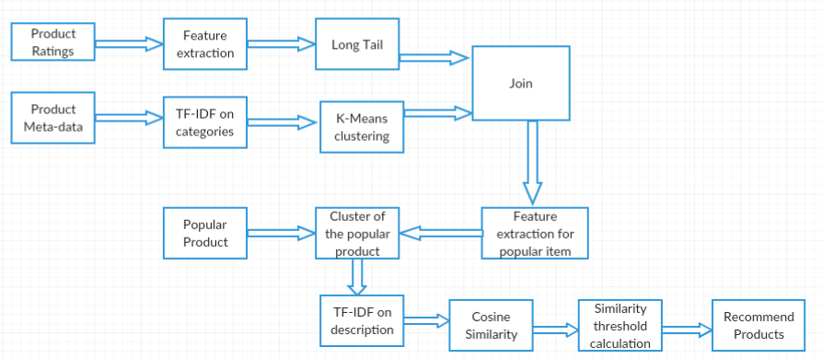
Workflow

Slide 88
Methods: Calculating the long tail
Find popularity index of each product
Popularity index = rating frequency of each product
Use elbow method to find long tail threshold
Classify products as head or tail based on a threshold

Slide 89
Methods: Finding similar products
Categorized Amazon Dataset : Books, Electronics, Video Games etc.
Our long tail recommendations algorithm is run category-wise for better recommendations
First level filtering : Find products in the same sub-category
Approach:
TF-IDF on category
K-Means clustering
Get the feature vector of each product.

Slide 90
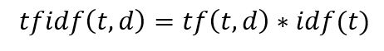
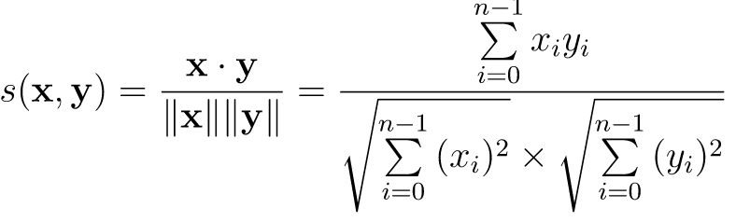
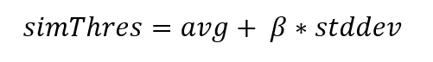
Methods: Recommendation
Choose a target popular item, say alpha
Find cluster containing alpha
Second level filtering: find items most similar to alpha
TF-IDF on description
Cosine similarity
Similarity threshold
Recommend items
Cosine similarity > threshold

Slide 91
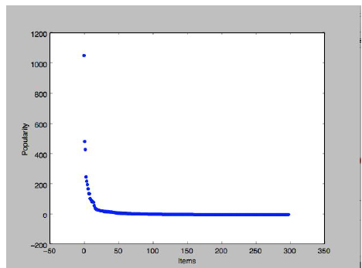
Results/Evaluation
Head and tail products for the category, Books.
Threshold defined on the basis of popularity-index to
segregate head and tail products

Slide 92




Results/Evaluation contd.
------------->
Tail product recommendations

Slide 93
Discussion
Long tail products are somewhere lost in the huge pile of products but with proper recommendation they can be made popular
Coarse-level clustering of products based on category
Product description was considered necessary for recommendation
Also generic description like “Brand new product” tend get high similarity resulting in noise
This is avoided by removing stopwords
This form of recommendation provides users with a diverse set of options for the products
Most items in related field were in head while most similar products were in tail.

Slide 94
Conclusion
The products were segregated into Head and Tail
The products are coarsely clustered based on categories
Product similarities were found by doing a cosine similarity on product description
This similarity was then used for recommending tail products
Long tail recommendation recommended most similar products from head and tail.

Slide 95
References
http://infolab.stanford.edu/~ullman/mmds/ch9.pdf
http://jmcauley.ucsd.edu/data/amazon/
The Long Tail of Recommender Systems and How to Leverage It
https://www.researchgate.net/profile/Diego_Peluffo/publication/286926602/figure/fig1/AS:306935011266560@1450190417862/Figure-1-Dimensionality-reduction-effect-over-a-Swiss-roll-manifold-Resultant-embedded.png
http://dataconomy.com/an-introduction-to-recommendation-engines/
https://i-msdn.sec.s-msft.com/dynimg/IC848332.jpeg

Slide 96


Slide 97

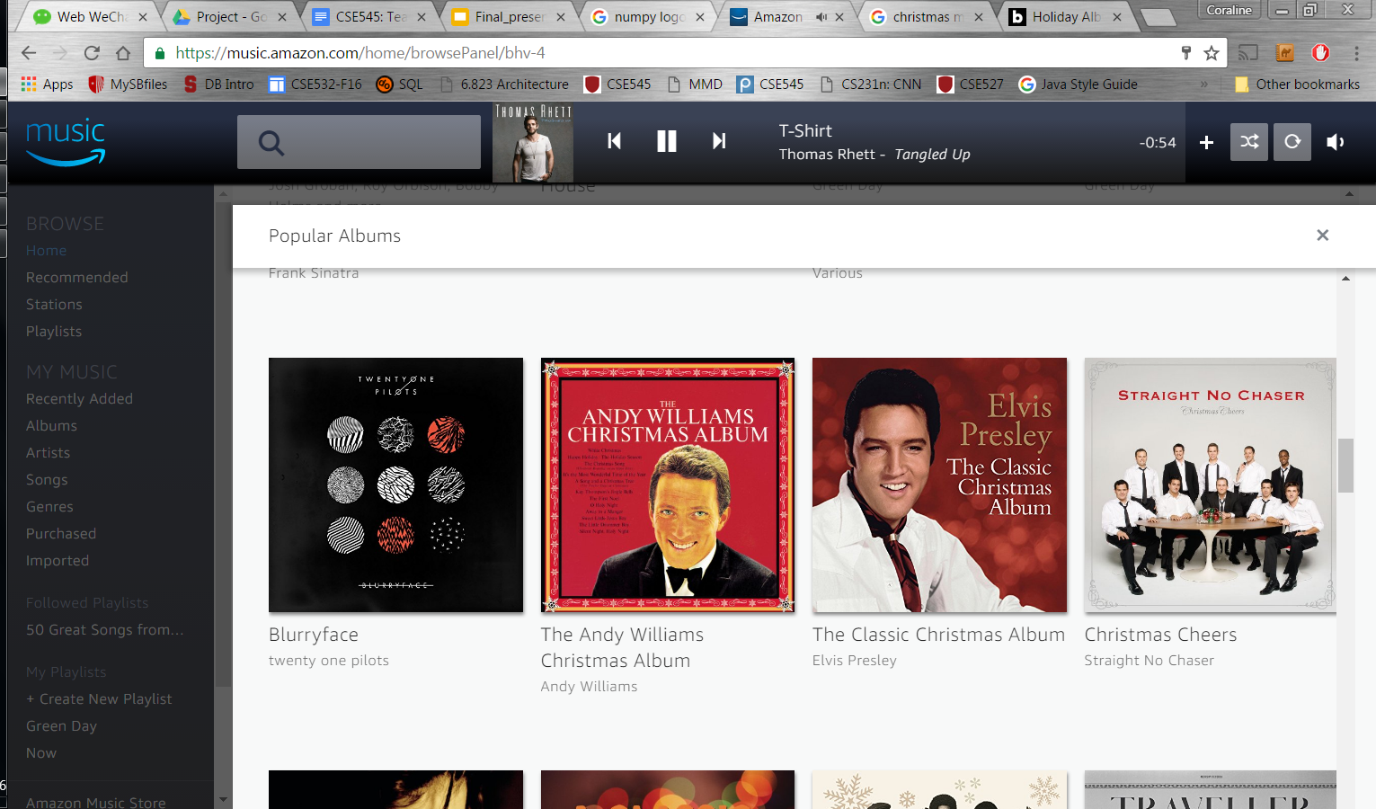
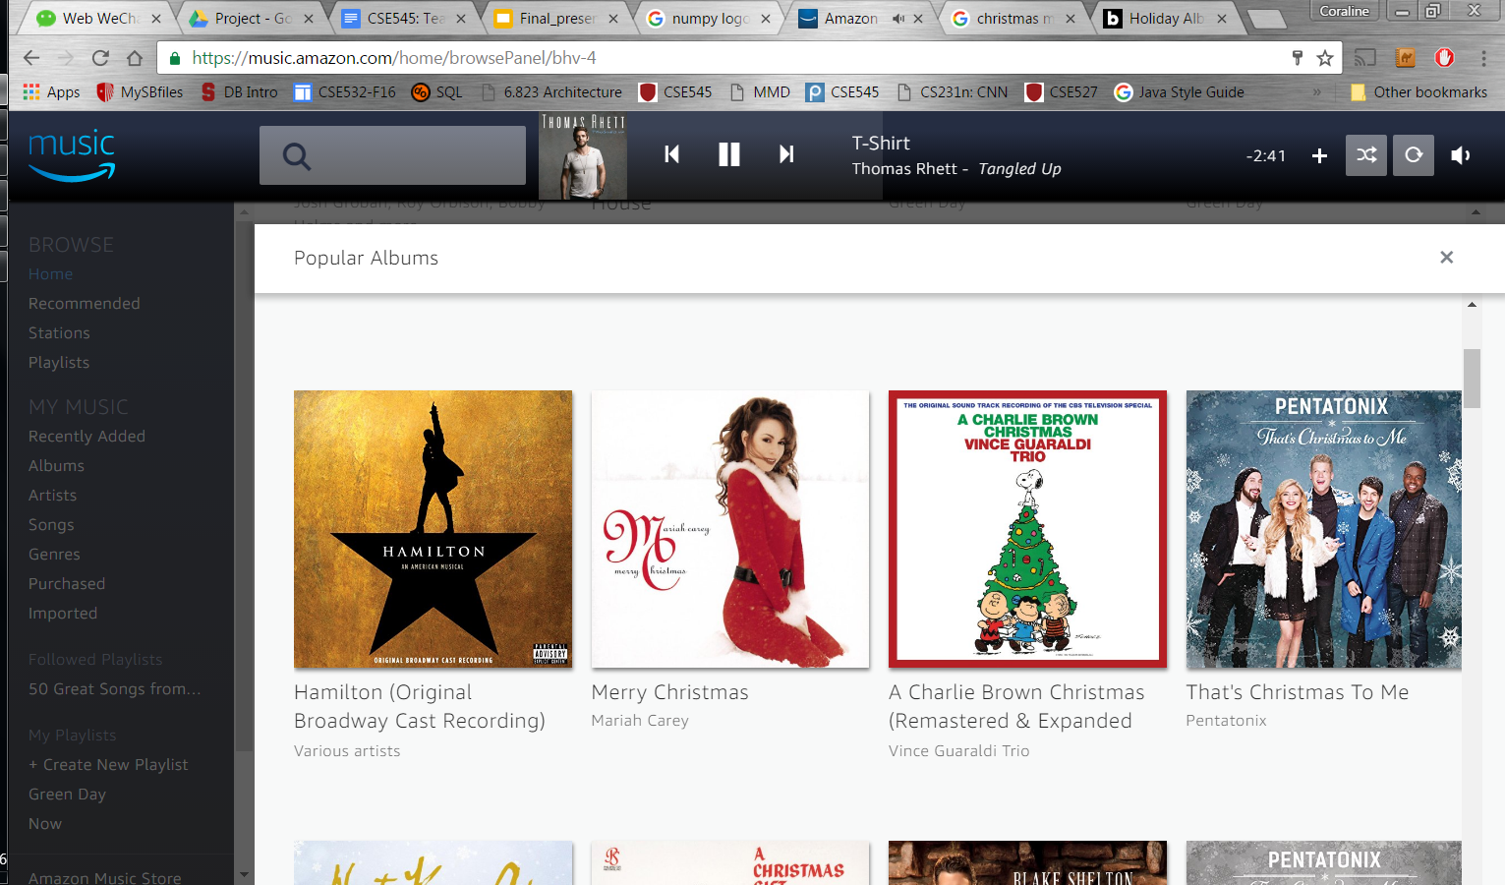

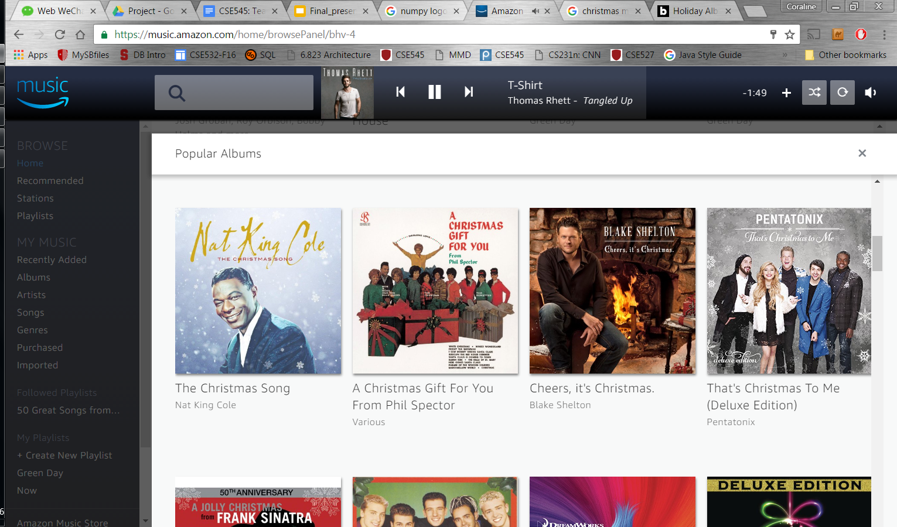
Recommendation System on Amazon Music Reviews
Han Li, Luping Su, Jiewen Zheng

Slide 98
Layout
Big Picture Scope and Motivation Review
Data and Tool Description
Methods Implementation Overview
Methods and Results Analyses
Conclusions

Slide 99
Big Picture Scope and Motivation Review
What does recommendation system (RSs) do?
RSs consist of algorithms and techniques which are used to provide suggestions for items that most likely of interest to a particular user.
For e-commerce business:
Cope with the long tail problem.
For users:
Overwhelmed by large number of items, need to be guided.

Slide 100
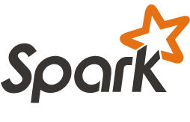




Data and Tool Description
Data set:
6 GB music reviews data from amazon.com
-- 6,396,350 reviews
-- 3 features used: productId, UserId, Rating
1.8 GB item description data
-- 154,310 item descriptions
-- 2 features used: ProductId, Product Description
Toolchain:
Spark (MLlib, GraphFrames, GraphX) is used for data mining. Pandas, numpy are used for data post-processing.
nltk. gensim are used for text processing and analyzing.
Matplotlib is used for data visualization and analysis.
Notes:
Data source
Amazon reviews, from 1995 to 2013
First stage data, baby products reviews, 141 MB
Second stage data, book reviews, 13 GB
Third stage data, several categories reviews combined, 5 GB
Variables
Raw data: product ID, title, price, user ID, profile name, helpfulness, score, time, summary, text
After extracted: Item ID, user ID, rating
Number of observations
First stage data, 184,887 observations
Second stage data, 12,886,488 observations
Third stage data, 10,885,332 observations

Slide 101
Methods Implementation Overview
Methods
Global Average Prediction
Collaborative Filtering
Latent Factor Model
Item-Item Collaborative Filtering
Ensemble Model
Average
Linear regression
Hybrid Filtering: Content Based with Item-Item Collaborative Filtering
Link Analysis: Personalized Pagerank (PPR)
baseline models
numerical rating prediction
top-rank items prediction

Slide 102
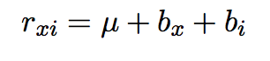
Methods: Global Average
Rating of Item i from User x:
Global average
User rating deviation
Item rating deviation
Root Mean Square Error (RMSE) : 0.91
Poor Accuracy
Baseline model
Reasonable and Intuitive
Fastest

Slide 103
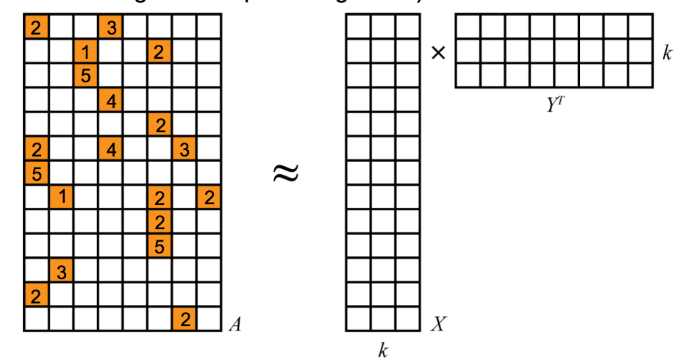
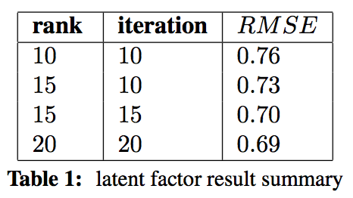
Methods: CF Latent Factor
Low Rank Matrix Factorization
alternating least squares (ALS)
Positive Correlation :
rank, iteration vs. RMSE
Tradeoff :
Training time consumption vs. accuracy
Not memory friendly

Slide 104
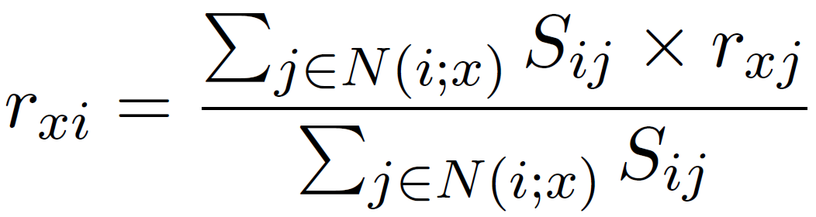
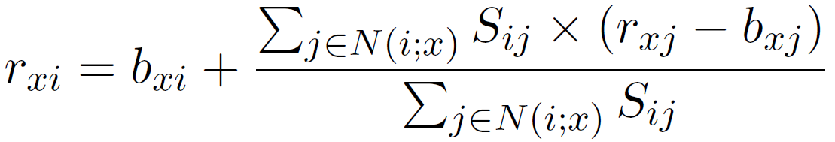
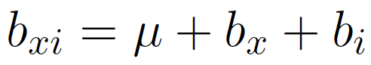

Methods: CF item-item
Average multiple ratings
item(30 users)
user(30 items)
97%/3% train/validation
Without baseline rating
Cosine similarity
Predict with 50 neighbors
With
baseline rating

Slide 105

Methods: CF item-item
RMSE = 0.39
RMSE = 0.35

Slide 106


Methods: ensemble model

Slide 107

Methods: ensemble model
4.9 4.7 5.0
4.7 4.8 5.0
2.9 2.9 3.0
4.9 4.8 5.0
4.9 4.7 5.0
3.0 3.4 3.0
4.5 4.0 4.0
4.7 4.3 5.0
4.8 4.7 5.0
4.1 4.1 4.0
… … ...
predicts
CF item-item
75%
new predicts
x
w1
w2
=
Latent factor
25%
weights
Method | RMSE
CF item-item with baseline rating | 0.34
Latent factor: iter=20, rank=20 | 0.47
Ensemble: averaging weight | 0.36
Ensemble: least-squares weight | 0.33
w1 = 0.82
w2 = 0.18

Slide 108
Methods: hybrid filtering
Item-item CF
Target item
Hybrid recommendation system
Phase I
Phase II
All
items
Target item
All
items
…...
…...
1
2
k-1
k
1
2
k-1
k
prediction
K subgroups
Goal:
Narrow down the calculation scope of item-item cf filtering.
prediction

Slide 109
Methods: hybrid filtering
Three steps in phase I:
Step 1: Preprocessing Data
Input: music item descriptions
1.1 From nltk import word_tokenize, stopwords, LancasterStemmer
1.2 Tokenize and lowercase input
1.3 Get rid of stop-words in input
1.4 Stem input
Output: text_preprocessed

Slide 110
Methods: hybrid filtering
Step 2: Train tf-idf Model
2.1 From gensim import models, corpus
2.1 Use TfidfModel to get tf-idf model with text preprocessed
2.2 Covert weighs in item document matrix into tfidf through trained model
OutPut: item_document_tfidf matrix
Step 3: Train LSI model and group data
3.1 Use LsiModel to do 5 rank SVD on item_document_tfidf matrix
3.2 Get matrix with document-topic relation value as its entries
3.3 For each document, choose the group number with the highest relation value.Assign each document to its group number
Output: list of (group number, document)

Slide 111
Methods: hybrid filtering
Value name |  | Value
Rank |  | 5
Subgroup Percent | Group1 percent | 16.1%
 | Group2 percent | 31.8%
 | Group3 percent | 20.3%
 | Group4 percent | 17.9%
 | Group5 percent | 13.9%
Average RMSE |  | 0.77
Total item descriptions: 154,310
music item descriptions : 16,035
Calculation scope reduction > 70%

Slide 112





Methods: Link Analysis - PPR
Global Page Rank Personalized Page Rank

Slide 113


Methods: Link Analysis --PPR
PPR for Recommendation System
Graph Construction
User nodes plus Item nodes
Bidirectional edges for positive user-item relationships
Bipartite Graph
PPR
One user node as starting node
Recommend top ranked items to starting user
Rt Evaluation

Slide 114


Methods: Link Analysis --PPR
Result Analysis : matters
large alpha--0.5
Force random walk back to source node too often
Lost large scope info
Obtain local neighbor nodes only
small alpha--0.1
reduce to global Page Rank
Recommend items with global popularity, not user specific recommendation
sensitive to alpha
best accuracy with
alpha=0.25

Slide 115
Conclusions
Recommendation System Models Implementation and Comparison
Global Average, Latent Factor baseline model
Item-Item CF baseline rating improvement
Ensemble Model more information is always better than less
Hybrid Model efficient CF calculation given content information
PPR random factor matters, experiment verified
Efficiency
Global Average, Latent Factor
Numerical Prediction
Ensemble Model
Hybrid Model, given enough content information
Top rank items
PPR

Slide 116
Thank you!

Slide 117
Reference
http://www.mmds.org/
matrix factorization techniques for recommender systems, Yehuda Koren Robert Bell and Chris Volinsky, 2009 IEEE Computer Society
https://docs.google.com/presentation/d/1YMPJGo62hRPDz1iXQK2fITJAFOJn6H3oPD5vsrMwA1c/edit#slide=id.g9ee6c821b_9_0
https://datasciencemadesimpler.wordpress.com/tag/alternating-least-squares/

Slide 118
Real-time Internet traffic classification
using Apache Spark platform
Swetambari Verma, Swatilekha Chaudhury, Rowan Menezes

Slide 119


PROBLEM DEFINITION
Petabytes of Data
ISP
VoIP
Downloads
Video Streaming
Web Browsing
Real-time Internet traffic classification using Apache Spark platform

Slide 120




MOTIVATION
Petabytes of Data
ISP
VoIP
Downloads
Video Streaming
Web Browsing
Advertising
Analytics
Load Balancing

Slide 121

CHALLENGE!!
Petabytes of Data
ISP
VoIP
Downloads
Video Streaming
Web Browsing
Data is Encrypted

Slide 122
SCOPE AND WHY BIG DATA!!
Petabytes of Data
ISP
VoIP
Downloads
Video Streaming
Web Browsing
Overwhelming Amount of Data ”BIG DATA”
Data is Encrypted

Slide 123




DATA SOURCES AND VARIABLES
Sources: Network Traces (At least 5GB)
Streaming Video (Youtube)
Downloads
VoIP (Hangouts)
Web Browsing

Slide 124
DATA FEATURES
Average packet size in bytes
The number of bytes per second
The number of bits per second
The number of ICMP and ICMPv6 packets
The standard deviation of the size of each packet in bytes
The network "load" over the last minute
The maximum packet size in bytes
The minimum packet size in bytes
The number of bytes,number of TCP/UDP packets
No of Observations: >5GB

Slide 125

METHODS
Machine Learning:
Training:
Input : Mixture Of Network Traces
Feature Vector Extraction
Machine Learning Model :
Supervised
Random Forest(on the basis of accuracy)

Slide 126

METHODS
Prediction :
Real-Time Network Traces are injected onto the spark stream(HDFS)
Data is classified by the classifier model
Real-Time Visualization Of the packets with the streaming network traces

Slide 127

RESULTS/EVALUATION

Slide 128



RESULTS/EVALUATION

Slide 129
DISCUSSION
Applications and businesses are moving towards encryption of network data making features extraction very limited and challenging.
Need to rely on features that don’t change with encryption like packet size, etc.
Parameters like network latency, packet loss and jitter effects on performance can be used to fine tune the accuracy even further.

Slide 130
CONCLUSION
Evaluated the classification accuracy of Naïve Bayes, Decision Tree, Random Forest and Logistics Regression.
Random Forest works the best for us.
End product is a real time visualization of the classification of data packets
Our work can be extended for other applications such as intrusion detections, anomaly detection in user data and control, routing traffic , building network profiles for proactive network etc.

Slide 131
REFERENCES
http://spark.apache.org/docs/latest/streaming-programming-guide.html
Thuy T.T. Nguyen and Grenville Armitage, A Survey of Techniques for Internet Traffic Classification using Machine Learning
Nigel Williams, Sebastian Zander, Grenville Armitage, A Preliminary Performance Comparison of Five Machine Learning Algorithms for Practical IP Traffic Flow Classification

Slide 132
THANK YOU

Slide 133

Sentiment Analysis for Streaming Data
_{Starks of House Spark}
Mayur Ghogale
Prasad Marla
Rashmi Narvekar

Slide 134
Big Picture Scope/ Motivation
Need:
Adjusting marketing strategy
Preventing spread of negative posts on social media
Understanding immediate impact of an action
Various dictionary based approaches for sentiment and emotion analysis
Dictionaries generated using different methods
Compare performance of different dictionaries
Combining multiple dictionaries to derive results

Slide 135
Data
Source
Streaming tweets taken from Twitter API
Data Dictionaries
Used 4 dictionaries with prelabeled word sentiments
Number of features
Each word in a tweet contributes towards the sentiment
All such words in stream are variables for analysis

Slide 136
Methods
Streaming
Used Apache Spark 2.0, Spark Twitter Streaming
Cleaning the tweet data
Calculating the score for the tweet
Sentiment Dictionaries
Charts for visualizing results
HighCharts

Slide 137


Spark Streaming
provides a high-level abstraction called discretized stream or DStream, which represents a continuous stream of data.
Authenticating with twitter APIs to receive stream of tweets
Stream duration
Limitations of twitter stream

Slide 138
Preprocessing
Retweets
Tweet URL
Language
Mentions

Slide 139

Sentiment Classification
Positive Sentiments
Negative Sentiments
Joy
Anticipation
Surprise
Trust
Anger
Disgust
Fear
Sadness
Plutchik's wheel of emotions

Slide 140
Dictionaries Used
NRC Word-Emotion Association Lexicon (also called EmoLex)
Created using Amazon’s Mechanical Turk service, hand curated large-scale emotion annotation
abandon
anger: 0 anticipation: 0 disgust: 0 fear: 1
sadness: 1 surprise: 0 trust: 0 joy: 0
NRC Hashtag Emotion Lexicon
coco
joy 1.01083104345388
disgust 0.259766664411
surprise 0.127128744738705

Slide 141
Dictionaries Used contd..
Sentiment Composition Lexicon of Opposing Polarity Phrases (SCL-OPP)
Unigrams, Bigrams, Trigrams
horror -0.906
peaceful 0.875
Affect and Intensity Lexicon
hate AFFECT_AVG -0.699095669
INTENSITY_AVG 0.056988328

Slide 142
Score Calculation
NRC Hashtag Emotion Lexicon
Score 1
NRC Word-Emotion Association Lexicon
Score 2
Tokenize
Vote
Result
Sentiment Composition Lexicon
Score 3
Affect and Intensity Lexicon
Score 4
Score > 0 Positive
Score < 0 Negative
Score = 0 Neutral

Slide 143

Results
Dictionary Comparison 1:
Combined Vs NRC-Hashtag-Emotion-Lexicon Vs NRC-Emotion-Lexicon.
Tweets Collected on “Obama” tag
Tweet Corpus = 20K+
NRC-Hashtag-Emotion-Lexicon performs better then Emotion Lexicon dictionary.
Cause:
Hashtag Lexicon built on twitter data.
More domain Knowledge.

Slide 144

Results
Dictionary Comparison 2:
NRC-Hashtag-Emotion-Lexicon Vs SCL OPP Vs Affect and Intensity Lexicon.
Tweets Collected on “Obama” tag
Tweet Corpus = 1000
NRC-Hashtag-Emotion-Lexicon performs better then other dictionary.
Cause:
SCL OPP contains equal unigrams and bigrams.
Affect and Intensity Lexicon built on Facebook posts and contain bigrams as well.

Slide 145

Results
Tweets Collected : #Happy tag.
Tweet Corpus : 2000 tweets
Prediction : 83%
Analysis
Tweets collected are annotated in a way they all contain happy tweets.
Dictionary accurately predicts happy tweets.
Provides results comparable to complex machine learning algorithms.

Slide 146

Results
Trend Analysis

Slide 147
Discussion
Domain of dictionary is an important parameter to consider while choosing a dictionary.
Multiple dictionaries improve accuracy.
Inclusion of bigrams would improve the accuracy further.
Dictionary approach can be a good alternative to complex machine learning algorithms.

Slide 148
Conclusions
Dictionaries like ' NRC Hashtag Emotion Lexicon' and ' NRC Word-Emotion Association Lexicon' perform well and gave good results.
Combining multiple dictionaries for calculating sentiments has a benefit that there is no need for complex machine learning algorithms to compute the sentiments and get acceptable results.

Slide 149
References
Saif Mohammad and Peter Turney, Crowdsourcing a Word-Emotion Association Lexicon, Computational Intelligence, 29 (3), 436-465, 2013.
Saif M. Mohammad, Svetlana Kiritchenko, Using Hashtags to Capture Fine Emotion Categories from Tweets, Computational Intelligence, in press.
Svetlana Kiritchenko and Saif M. Mohammad , Sentiment Composition of Words with Opposing Polarities. In Proceedings of the 15th Annual Conference of the North American Chapter of the Association for Computational Linguistics: Human Language Technologies. June 2016. San Diego, CA.
H. Andrew Schwartz, Daniel Preotiuc-Pietro, Gregory Park, Johannes C. Eichstaedt, Margaret Kern, Lyle Ungar, Elizabeth P. Shulman, Modelling Valence and Arousal in Facebook posts.
Libraries :
http://www.highcharts.com/products/highcharts
http://twitter4j.org/en/

Slide 150


Slide 151
Music Recommendation System
Team : BlackBirds
Kumari Shalini, Mondrita Sengupta, Parag Gupta, Sumol Lodha

Slide 152
Big Picture Scope
In this project, we aim to build a music recommendation system of our own using the Million Song Dataset http://labrosa.ee.columbia.edu/millionsong
We have used content based model, collaborative filtering model and ensemble model to build and evaluate our recommendation system.

Slide 153
Motivation
Recommendation systems have become more and more popular due to ever increasing data.
Currently there are more that 15 million songs.
Hence, developing a personalized recommender system will help the user to cope up with such rapidly increasing songs catalogue.
Applied concepts learned in this course : content based recommendation model, collaborative filtering, association rules.
Everyone loves music.

Slide 154
Data Description
Data retrieved from Million Song Dataset [http://labrosa.ee.columbia.edu/millionsong/]
We are taking the subset of the data [(http://labrosa.ee.columbia.edu/millionsong/tasteprofile)]. It consists of :-
Approx 1 million unique users
Approx 400K unique MSD songs
Approx 50 million triplets (user, song, play count)
Contains audio features and metadata for a million contemporary popular music tracks.
Training dataset contains full history of 1 million users. Validation and Test dataset contains around 110K users whose half of the history is visible and rest half are hidden which needs to be predicted.
Full Million Song Dataset from AWS [https://aws.amazon.com/datasets/million-song-dataset/]

Slide 155

Recommendation Approaches
CONTENT BASED METHODS
COLLABORATIVE FILTERING
MIXED MODEL
Collaborative-filtering + Top-K Songs
Collaborative-filtering + Association Rules

Slide 156
Team Work
Content-Based Filtering - Shalini and Mondrita
End-to-End Code [Subset + AWS Cluster]
Visualization
Collaborative Filtering - Parag and Sumol
Item-to-Item Collaborative filtering (End-to-End Code)
Ensemble models : Collaborative, Association Rules, Top-K, log-scaling
Results and Analysis - All

Slide 157
Content Based Filtering
Data Required
Data Preprocessing
Feature Selection
Linear Regression Model
Challenges
Results
Topics Covered

Slide 158
Pipeline
Parsing and Loading Data
Parse HDF5 data -> extract features -> dump CSV
Load into RDD
Visualization
Correlation between features, removed uncorrelated to play count
Prepare Train and Test Data
Filtered data, Spark transformations - Map, Join
Machine Learning Algorithm
Convert into LabeledPoint RDD
Spark MLlib Linear Regression with SGD
Evaluation & Results
Train - 60%, Test - 40%, Predicted score for 1 million, Precision on top 500

Slide 159
Data Required
Training File - It contains triplets of (userID, songID, playCount). The size of input file is 3GB
Song to Track File - This file contains the song ID to track ID mapping data. It contains track ID's of total 3 million songs.
Million Song Dataset - Containing 55 features for every song.
Subset Dataset - 1.8 GB compressed, approx 100K songs
Full Dataset from AWS - 500 GB data for million song tracks.
File format - ‘.h5’ file having trackID as the name.

Slide 160
Data Preprocessing
Python code to parse data in HDF5 files and extract features
Filtered all those users from the training set who has listened to more than 25 songs.
Randomly chose 200 users with listening history of at least 25 songs.
Created the map of user's songs to trackID and extracted all the features corresponding to these track IDs from AWS Million Song Public Dataset
Handled the missing values by replacing it with the mean value of that particular feature.

Slide 161




Feature Selection
Artist Familiarity
Artist Hottness
Dancebility
Key Signature Confidence
Time Signature
Time Signature Confidence
Duration
End Of FadeIn
Energy
Loudness
Song Hotness
Tempo

Slide 162
Linear Regression Model
Aim to learn the weights of the song's features.
A user's songs history data are split in :-
training dataset containing 60 %
testing dataset containing 40%
Independent variable X is defined as the set of song's features
Dependent variable Y is defined as the variable that shows the relative importance of each song's to the user.
It is calculated as the normalized value of play count. Hence, the values of y lies in range [0, 1]. The top recommendations are chosen based on the threshold 0.5.

Slide 163
Challenges
Unavailability of metadata for every song in MSD subset.
Only those users with at least 10 songs meta-data present filtered from 100K users dataset.
Later, we used whole MSD dataset to get the results.
Passing RDD in ML algorithm was a challenge.
Model trained for million users, pass the RDD reference using map function not feasible
Instead applied for loop to train the model
Model referencing is not possible, so testing for multiple users in parallel was a difficult task. Created our own scoring function.

Slide 164
Code Flow
SongFV [SongID, FV]
Filter SongFV RDD
UserFV RDD
Join
Map
UserTriplet
[User, Song, Count]
Map
SongUserRDD
Song, (usr, sng, count)
trainRDD[user, (songFV, count)]
Train LR
ModelRDD cartesian SongFV
Train LR Model for each user
Groupby user [user, list [LabeledPoint]]
[User, LabeledPoint[count, songFV]]
Scoring Function
func LRPredict (Model, newSongFV)
Match the score of top 500 with the testing set and calculate precision

Slide 165
Results
Selected top 25 users who listened to maximum number of songs.
From here, we got total 26,837 songs.
We have average 1,300 songs per user.
The user with the maximum number of songs has 1,651 songs in his listening history.
The final precision is calculated.
Precision | Total Users
less than 0.05 | 13
Between 0.05 and 0.1 | 9
Between 0.1 and 0.2 | 2

Slide 166
Collaborative Filtering and Mixed models
Data Preprocessing
Collaborative Filtering
CF + Log-Scaling Model
CF + Top-K Model
CF + Association Rules Model
Results
Topics Covered

Slide 167


Data Preprocessing
Songs listened by less than 10 distinct users are filtered out
Users who have listened less than 5 unique songs are filtered out

Slide 168

Baseline Model
For a particular user, each song’s rating (listening count) is predicted in the following way:
Normalization
Cosine similarity between each pair of item
For each user we take the top 500 rated songs (up to) and recommend them.
Precision is calculated based on :
#(Listened song’s from Recommended songs)/ #(Recommended songs)

Slide 169
Log-Scaling of Baseline Model
Listening frequency of a user can vary tremendously
Highest frequency -> 99
Becomes hard to weigh every user listening history equally
Thus, log-scaled to mold the data between 1.0 - 5.0 scale
16% improvement in the precision

Slide 170
Collaborative-filtering + Top-K Songs
Extracted, sorted and selected the most listened songs by the users
Picked k = 50
Results got worse i.e precision decreased
#(Listened song’s from Recommended songs)/ #(Recommended songs)
Increase in denominator > Increase in numerator

Slide 171
Collaborative-filtering + Association Rules
Considered listening history of a user as a bag of items
Applied association rule mining with parameters
K=4
support = 15
confidence = 0.04
interest=0.01
Improved results and recommendations

Slide 172
Results
Variation | Precision
Collab Filtering | 0.0180
Association Rules | 0.0199
Rules + log-scaling | 0.0239
Rules + Top-K | 0.0185

Slide 173
Discussion
Mixed model ‘Collaborative-filtering + Popular songs’ didn't give better results compared to only Collaborative filtering. Probable reason - item based collaborative filtering model takes care of popularity.
Mixed model ‘Collaborative-filtering + Association Rules’ gave better results when combined with item based collaborative filtering.
In Content-Based Method, we achieved highest precision of approx 0.2 for user's with maximum listening songs history. In this approach, we only used features that describe the content of a song like tempo, song hotness, fade in and fade out etc. This limits our model to cluster the songs based on the content similarity.

Slide 174
Conclusion
We got hands-on experience of dealing with such a large-scale real-world dataset.
We learned the importance of distributed system without which handling such amount of growing data is a very tedious task.
Building an efficient utility matrix for millions song was a great challenge.
Future Scope - In Content-Based approach, we aim to include the artist locations and the song category to cluster similar songs.

Slide 175
THANK YOU

